Slide 1

Determinants of Economic Mobility

Slide 2
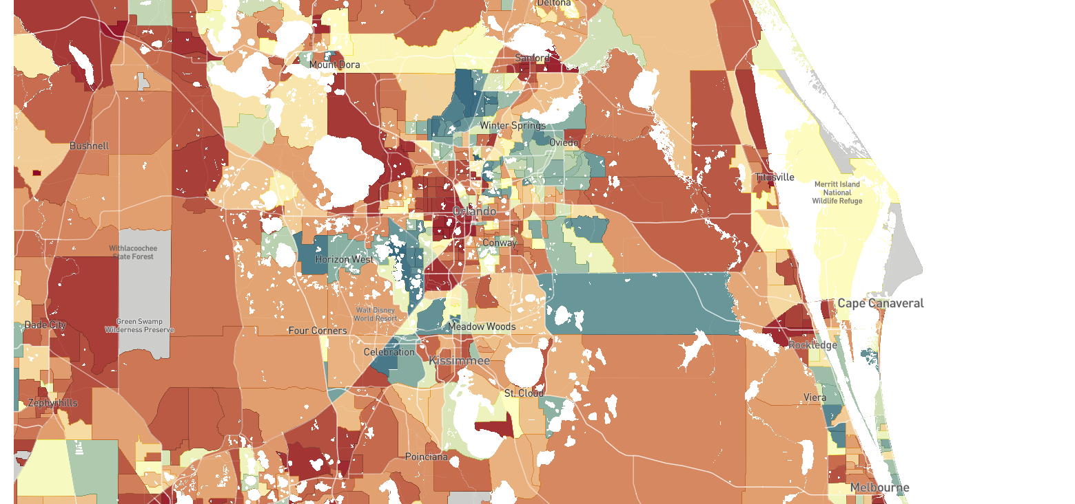

The Geography of Upward Mobility in Orlando
Average Income at Age 35 for Children whose Parents Earned $41K (25th percentile)
See estimates for other cities at The Opportunity Atlas
www.opportunityatlas.org
<$30k
$50k
>$83k
Note: Blue = More Upward Mobility
Red = Less Upward Mobility
Source: Chetty, Friedman, Hendren, Jones, Porter (NBER wp 2018)

Slide 3
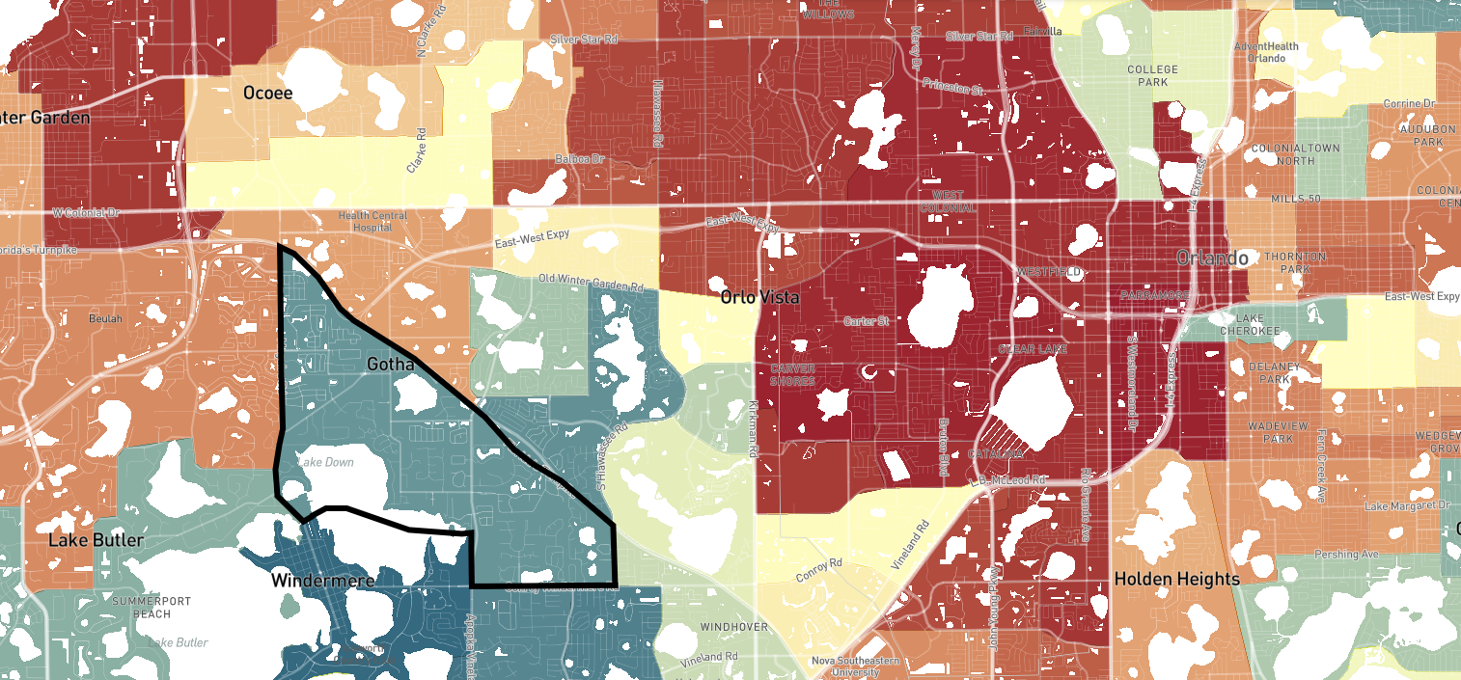
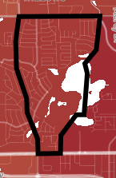
The Geography of Upward Mobility in Orlando
Average Income at Age 35 for Children Born in 1980 whose Parents Earned $41K (25th percentile)
Pine Hills
Gotha
Source: Chetty, Friedman, Hendren, Jones, Porter (AER 2026)
Notes:
Gotha: 62K (2025$)
Pine Hills: 34.5K (2025$)

Slide 4
Income Gain from Moving to a Higher Opportunity Neighborhood
By Child’s Age at Move
$51.3K
Gotha
$45.6K
Average Income at Age 35
$40.1K
$34.5K
Pine Hills
2
10
20
28
Age of Child when Parents Move
Source: Chetty and Hendren (QJE 2018)

Slide 5
Income Gain from Moving to a Higher Opportunity Neighborhood
By Child’s Age at Move
$51.3K
Move at age 2 from Pine Hills to Gotha
→ average earnings of $49,350
Gotha
$45.6K
Average Income at Age 35
$40.1K
$34.5K
Pine Hills
2
10
20
28
Age of Child when Parents Move
Source: Chetty and Hendren (QJE 2018)

Slide 6
Income Gain from Moving to a Higher Opportunity Neighborhood
By Child’s Age at Move
$51.3K
Gotha
$45.6K
Average Income at Age 35
$40.1K
$34.5K
Pine Hills
2
10
20
28
Age of Child when Parents Move
Source: Chetty and Hendren (QJE 2018)

Slide 7
Income Gain from Moving to a Higher Opportunity Neighborhood
By Child’s Age at Move
$51.3K
Gotha
$45.6K
Average Income at Age 35
$40.1K
$34.5K
Pine Hills
2
10
20
28
Age of Child when Parents Move
Source: Chetty and Hendren (QJE 2018)

Slide 8
Characteristics of High-Mobility Neighborhoods
Lower Poverty Rates
More Stable Family Structure
Better
School Quality
Greater Social Capital

Slide 9
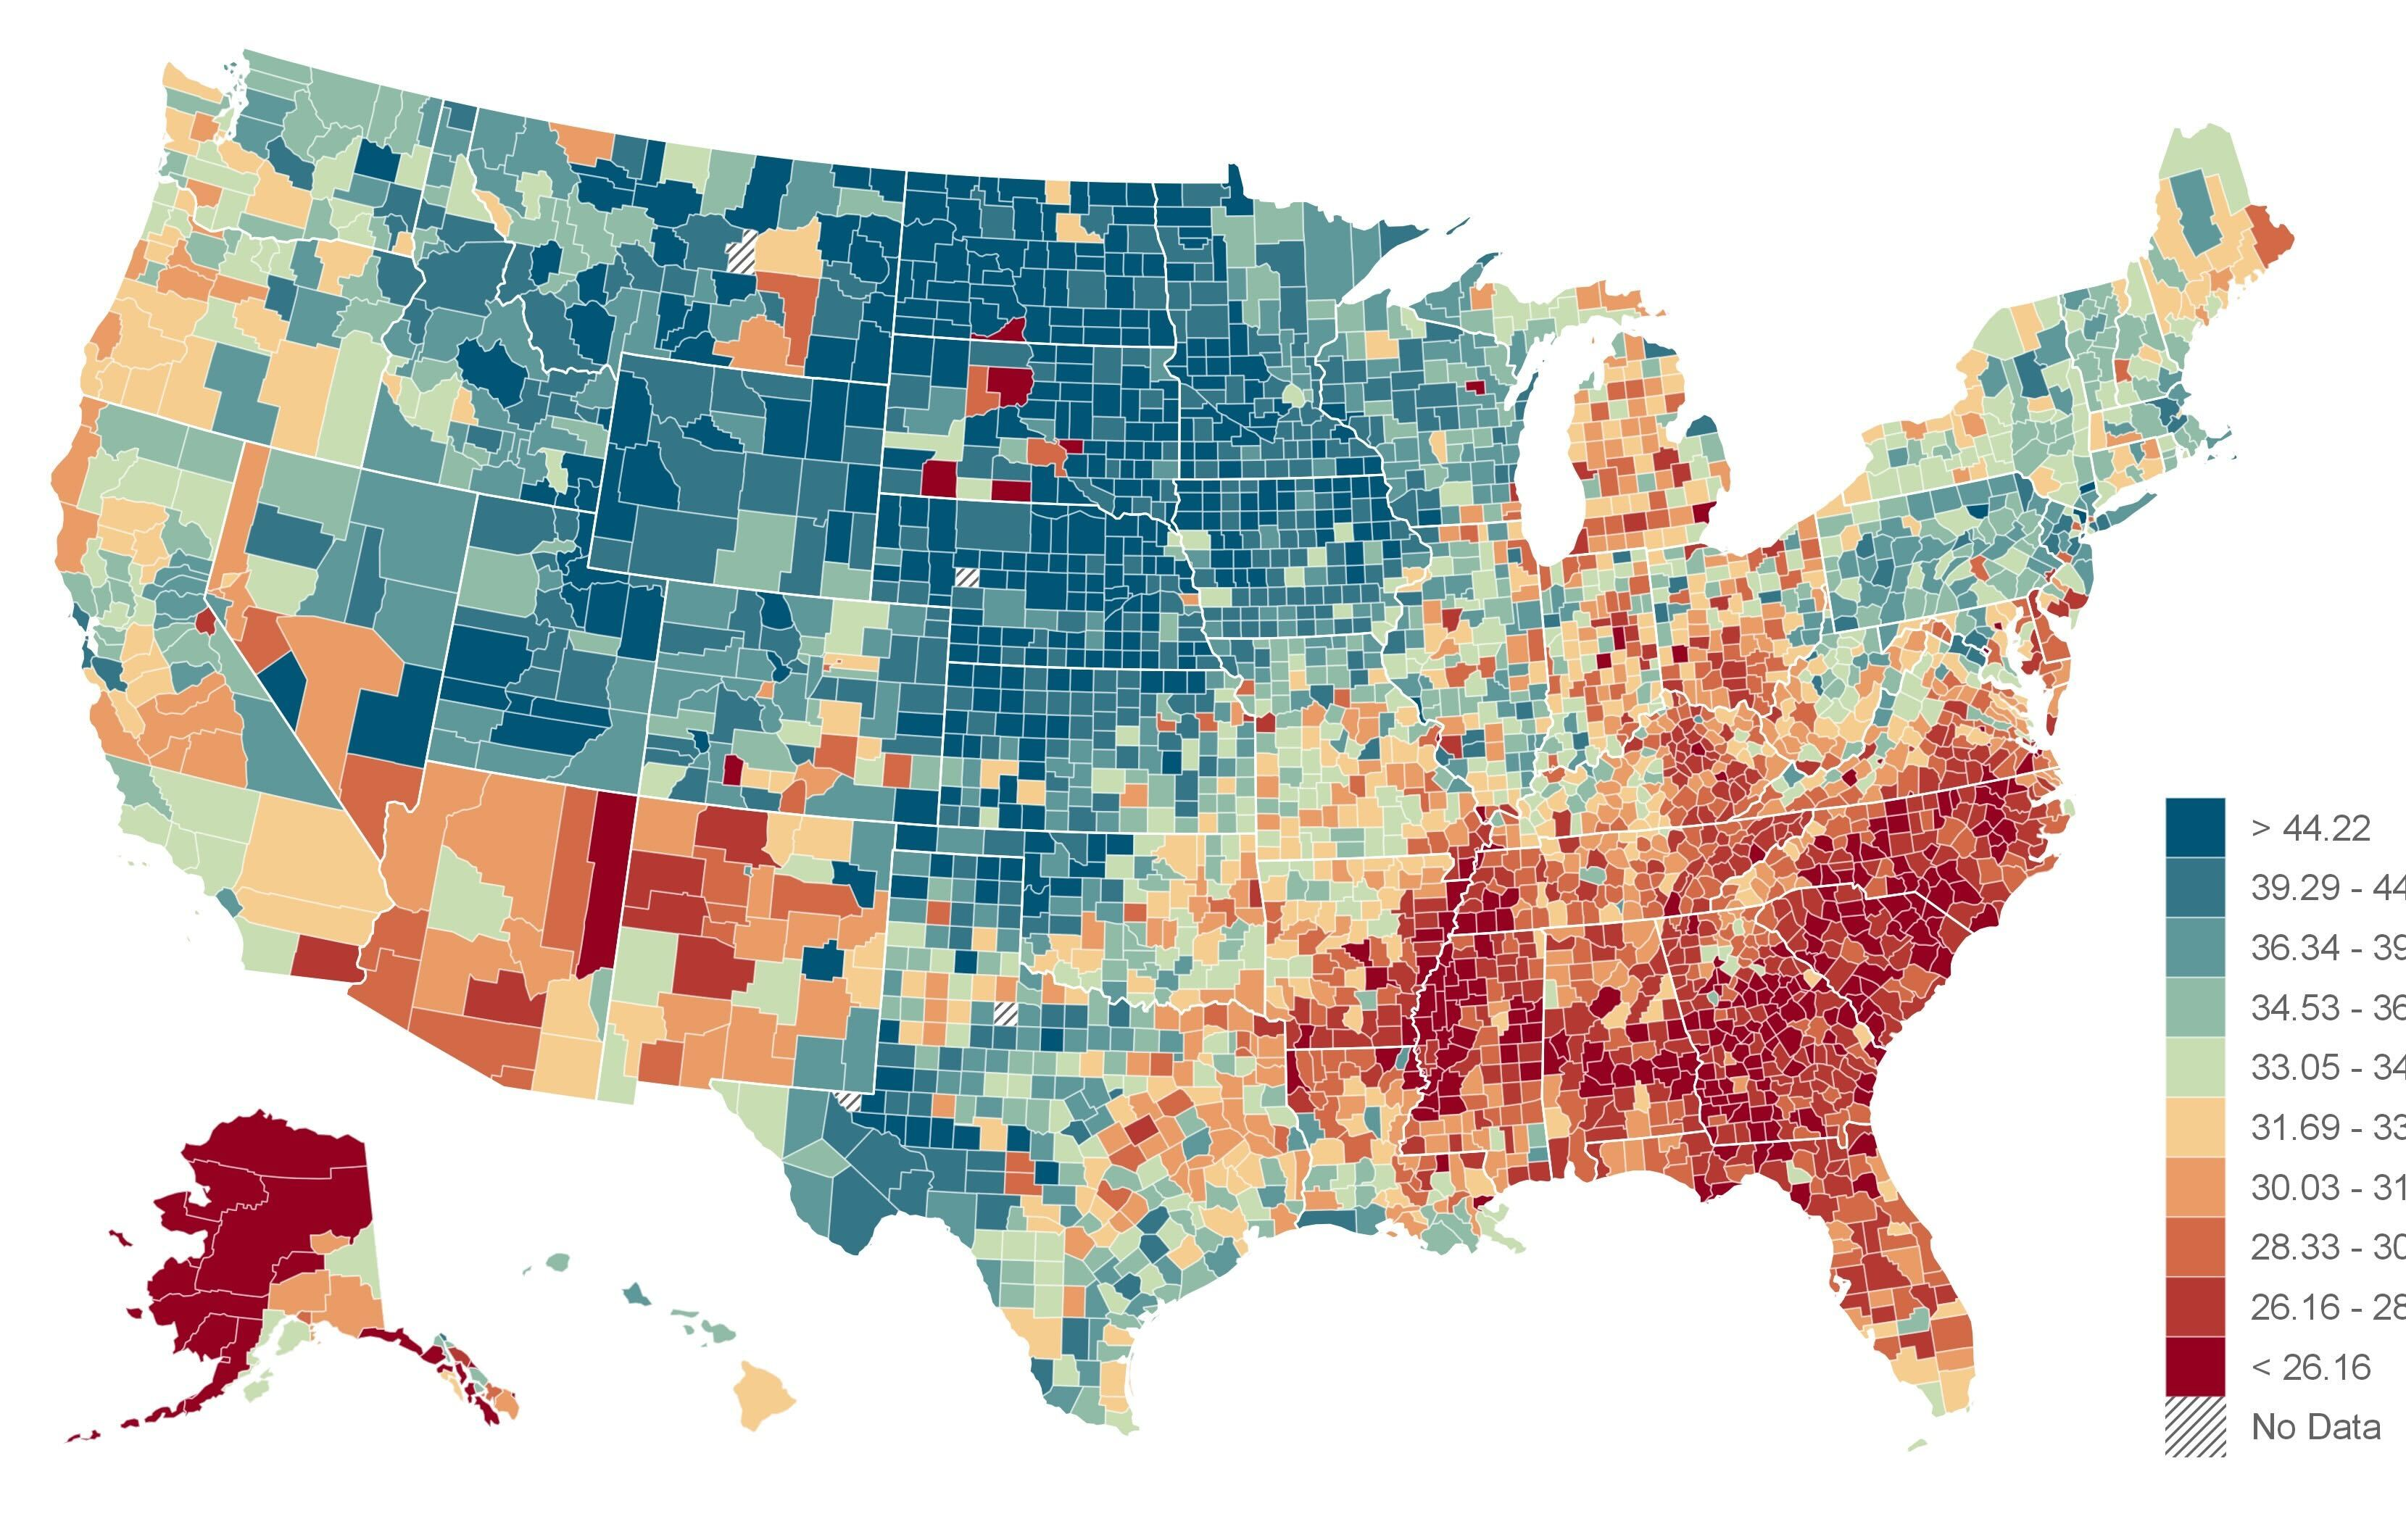
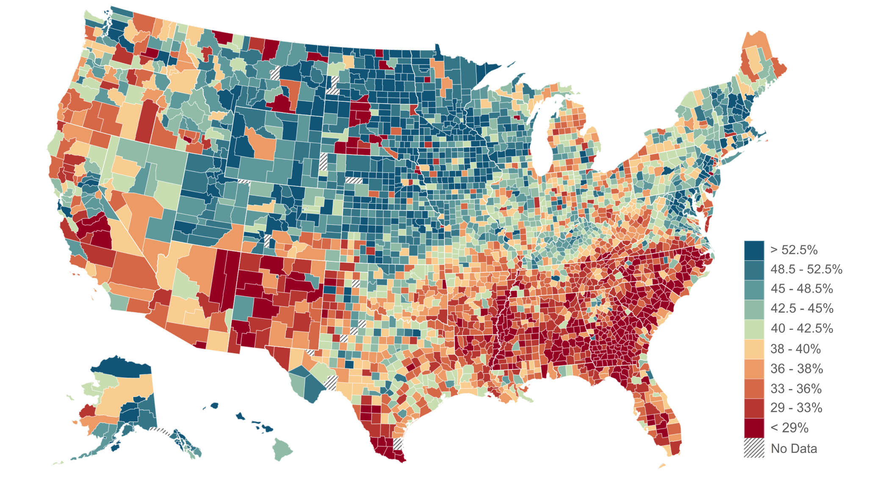

Economic Opportunity and Social Capital
Upward Mobility
Based on Tax Records
Economic Connectedness Based on Facebook Data
>$44k
> 52.5%
$33k
38% - 40%
<$27k
< 29%
Average Household Income at Age 35
for Children whose Parents Earned $41k
Share of Above-Median-Income Friends
among Below-Median-Income People
Source: Chetty, Friedman, Hendren, Jones, Porter (AER 2026); Chetty, Jackson, Kuchler, Stroebel et al. (Nature 2022)

Slide 10
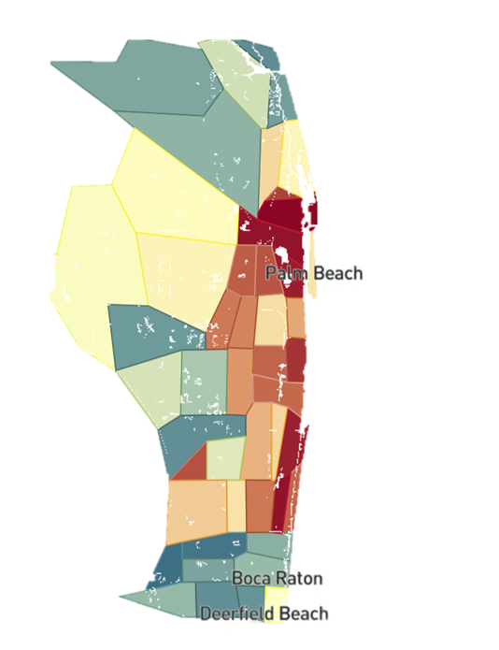
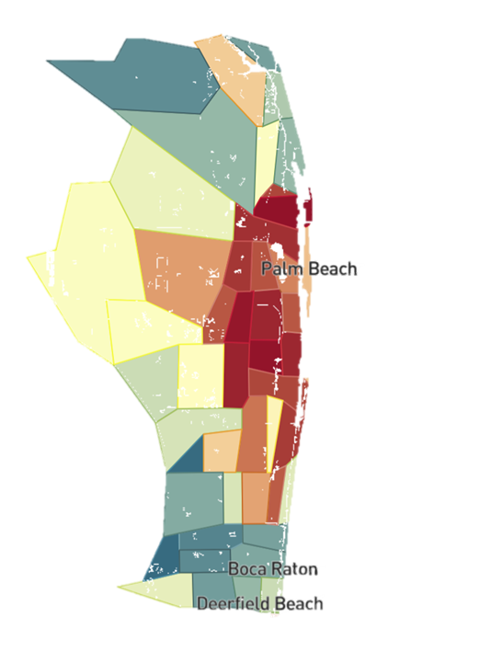
Economic Opportunity and Social Capital
Florida
Upward Mobility
Based on Tax Records
Economic Connectedness Based on Facebook Data
Average Household Income at Age 35
for Children whose Parents Earned $41k
Share of Above-Median-Income Friends
among Below-Median-Income People
Source: Chetty, Friedman, Hendren, Jones, Porter (AER 2026); Chetty, Jackson, Kuchler, Stroebel et al. (Nature 2022)

Slide 11
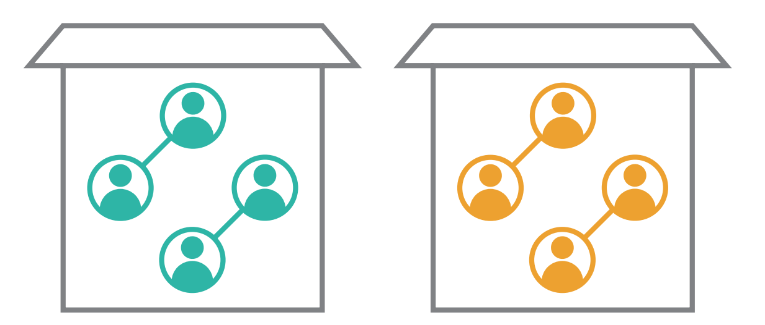
Determinants of Economic Connectedness
Exposure
Friending Bias
Segregation by income
Interaction conditional on exposure
High income
Low income
Source: Chetty, Jackson, Kuchler, Stroebel et al. (Nature 2022b)

Slide 12
Determinants of Economic Connectedness
50% Exposure
Every time I walked across Eutaw Street, I witnessed the exchange of realities. As I grew older, I’ve come to learn that this was how Baltimore works.
Millionaires could live on one side of a street, and the projects could be on the other side.
Those two worlds would never cross, never make friends, never acknowledge each other. Everybody was OK with it, especially the rich.
- Carmelo Anthony
Where Tomorrows Aren’t Promised (2021)
Segregation by income
50% Friending Bias
Interaction conditional on exposure

Slide 13
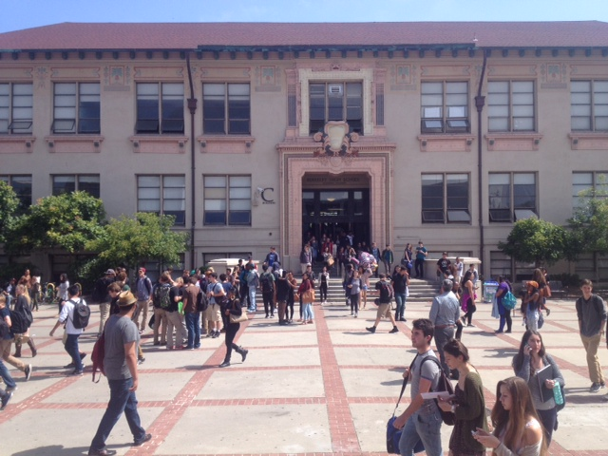

Initiatives to Increase Cross-Class Interaction in High Schools
2017
A Structure of Division: Berkeley High School attempts to tackle segregation on campus
To attempt to address this divisive climate, Berkeley High’s Design Team has proposed the creation of a ninth grade that places incoming students into intentionally diverse communities. Under a universal ninth grade, students would begin their time at Berkeley High in one of various houses, rather than in one of the five learning communities.
Berkeley High School
Source: The Daily Californian (2017)

Slide 14
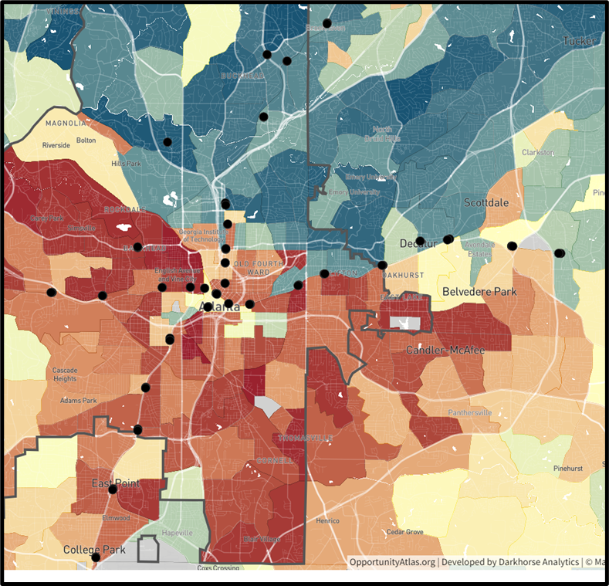

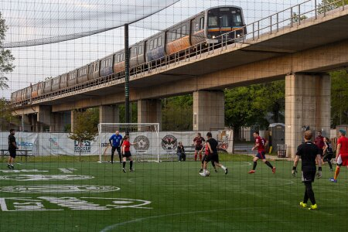
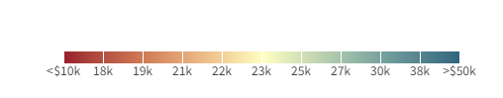
Increasing Cross-Class Interaction Through Urban Design
2023
Connecting Communities: Adding Soccer Fields to Atlanta’s MARTA Stations
MARTA Stations
Source: Urbanland (2023)

Slide 15
Additional Social Capital Slides

Slide 16
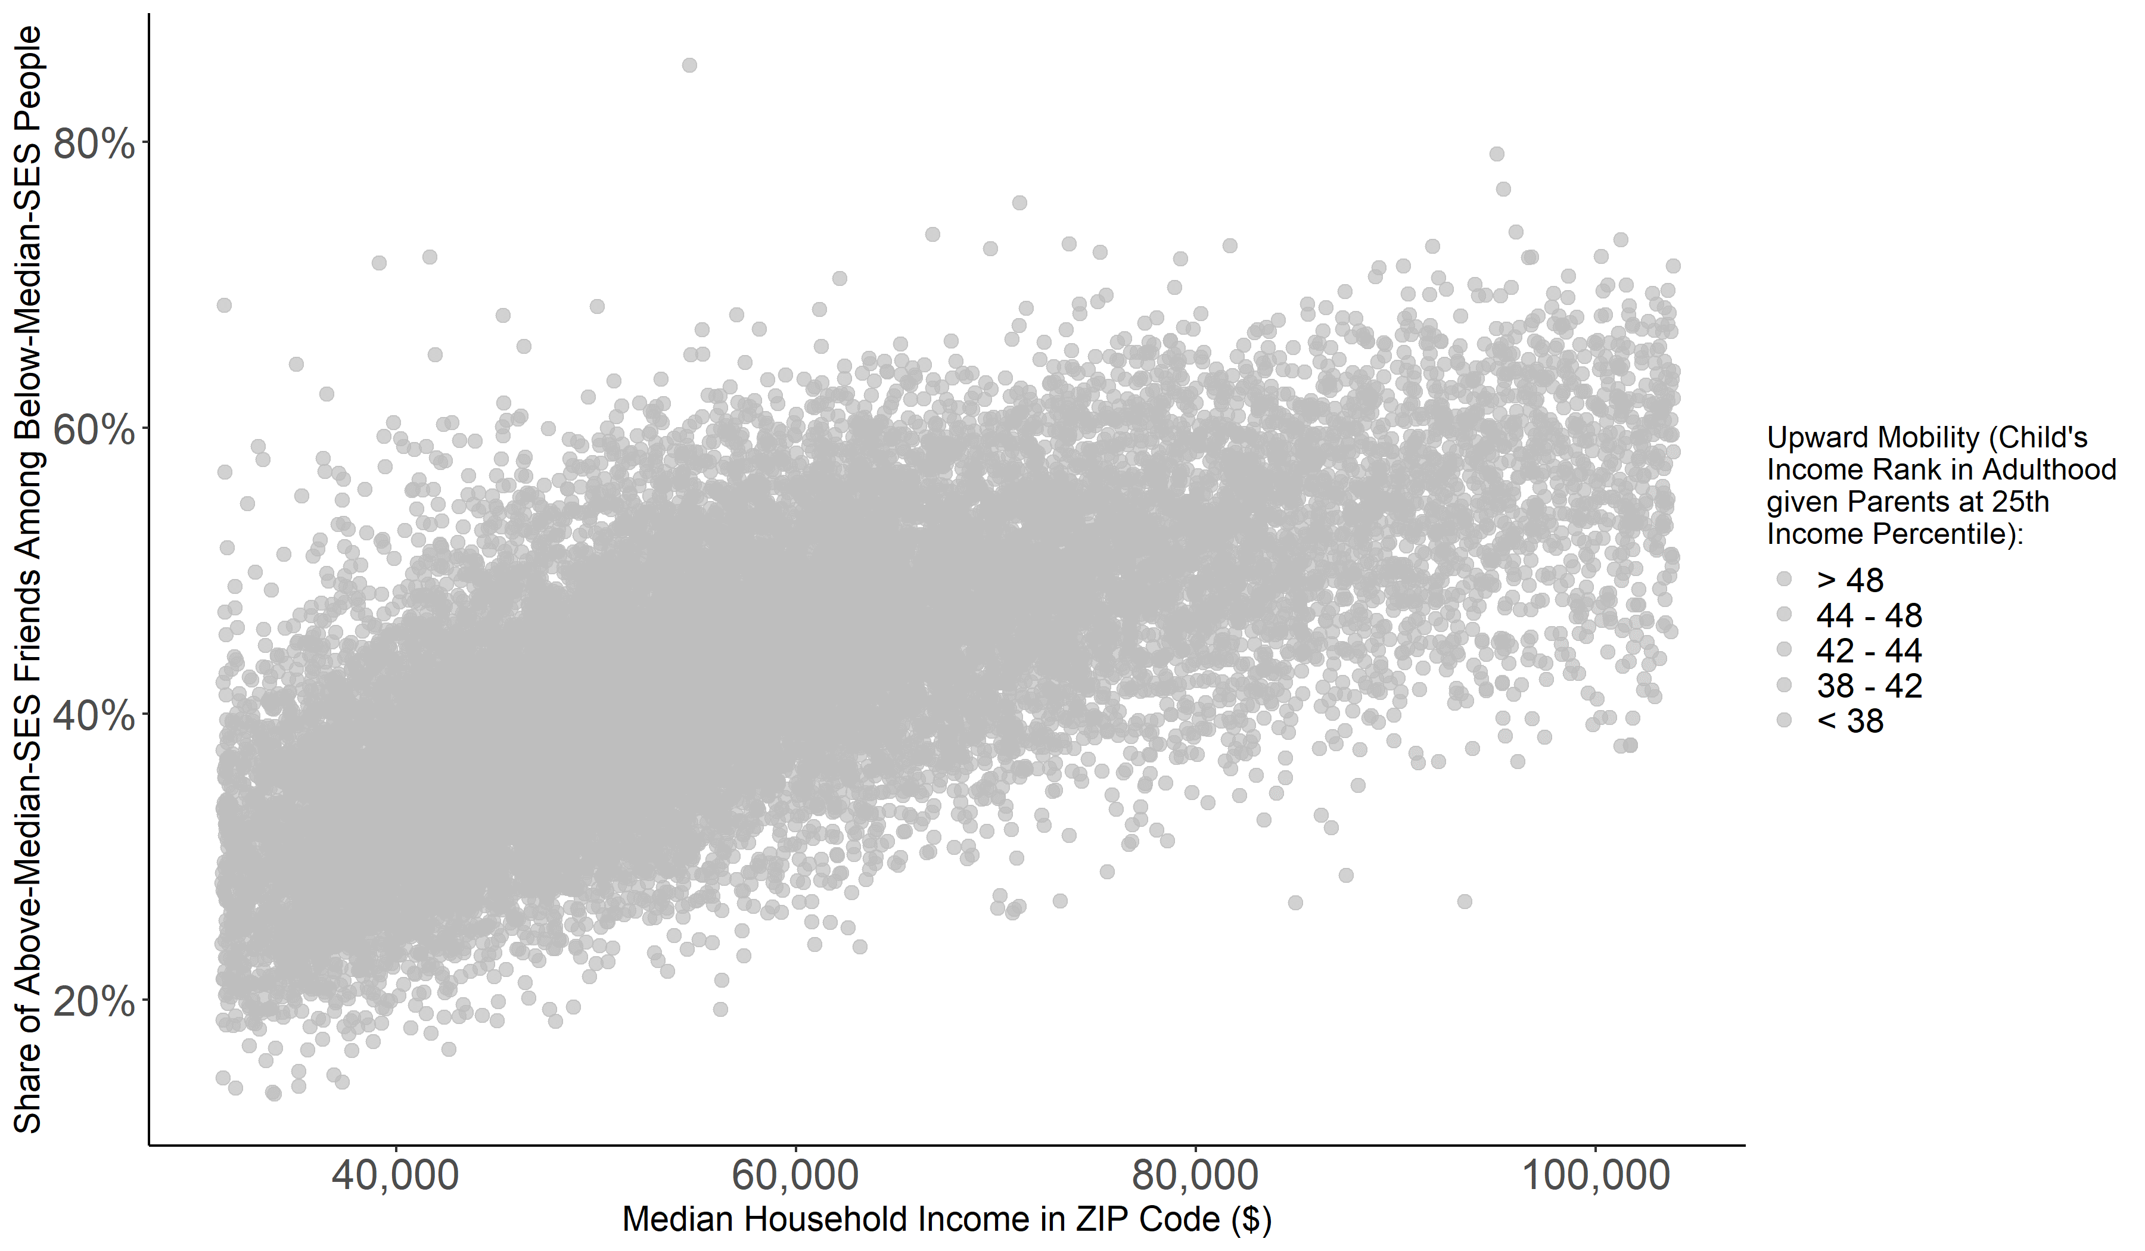




Economic Opportunity and Social Capital
Source: Chetty, Friedman, Hendren, Jones, Porter (2018); Chetty, Jackson, Kuchler, Stroebel et al. (Nature 2022)

Slide 17
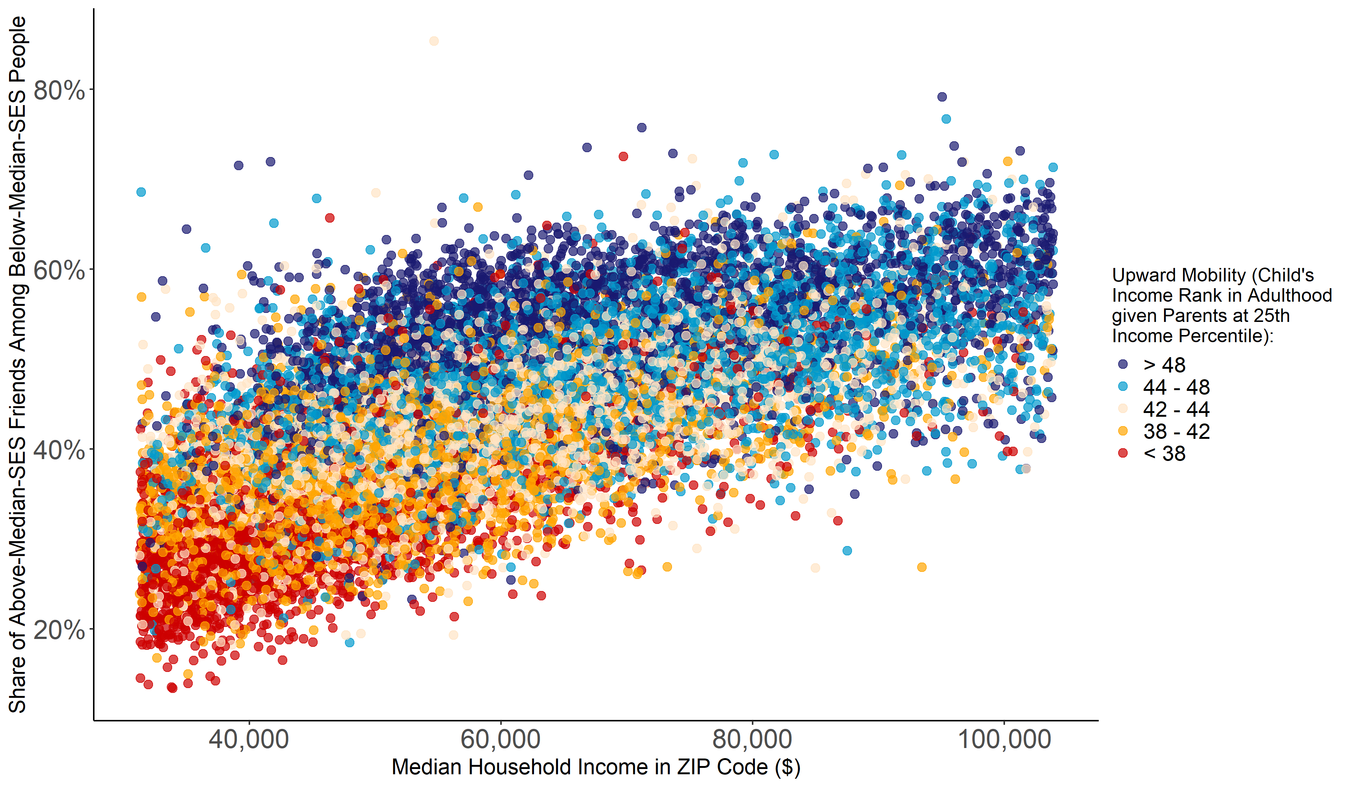
Economic Opportunity and Social Capital
Colored by Rate of Economic Mobility
Source: Chetty, Friedman, Hendren, Jones, Porter (2018); Chetty, Jackson, Kuchler, Stroebel et al. (Nature 2022)

Slide 18
Economic Opportunity and Social Capital
Colored by Rate of Economic Mobility
Source: Chetty, Friedman, Hendren, Jones, Porter (2018); Chetty, Jackson, Kuchler, Stroebel et al. (Nature 2022)

Slide 19
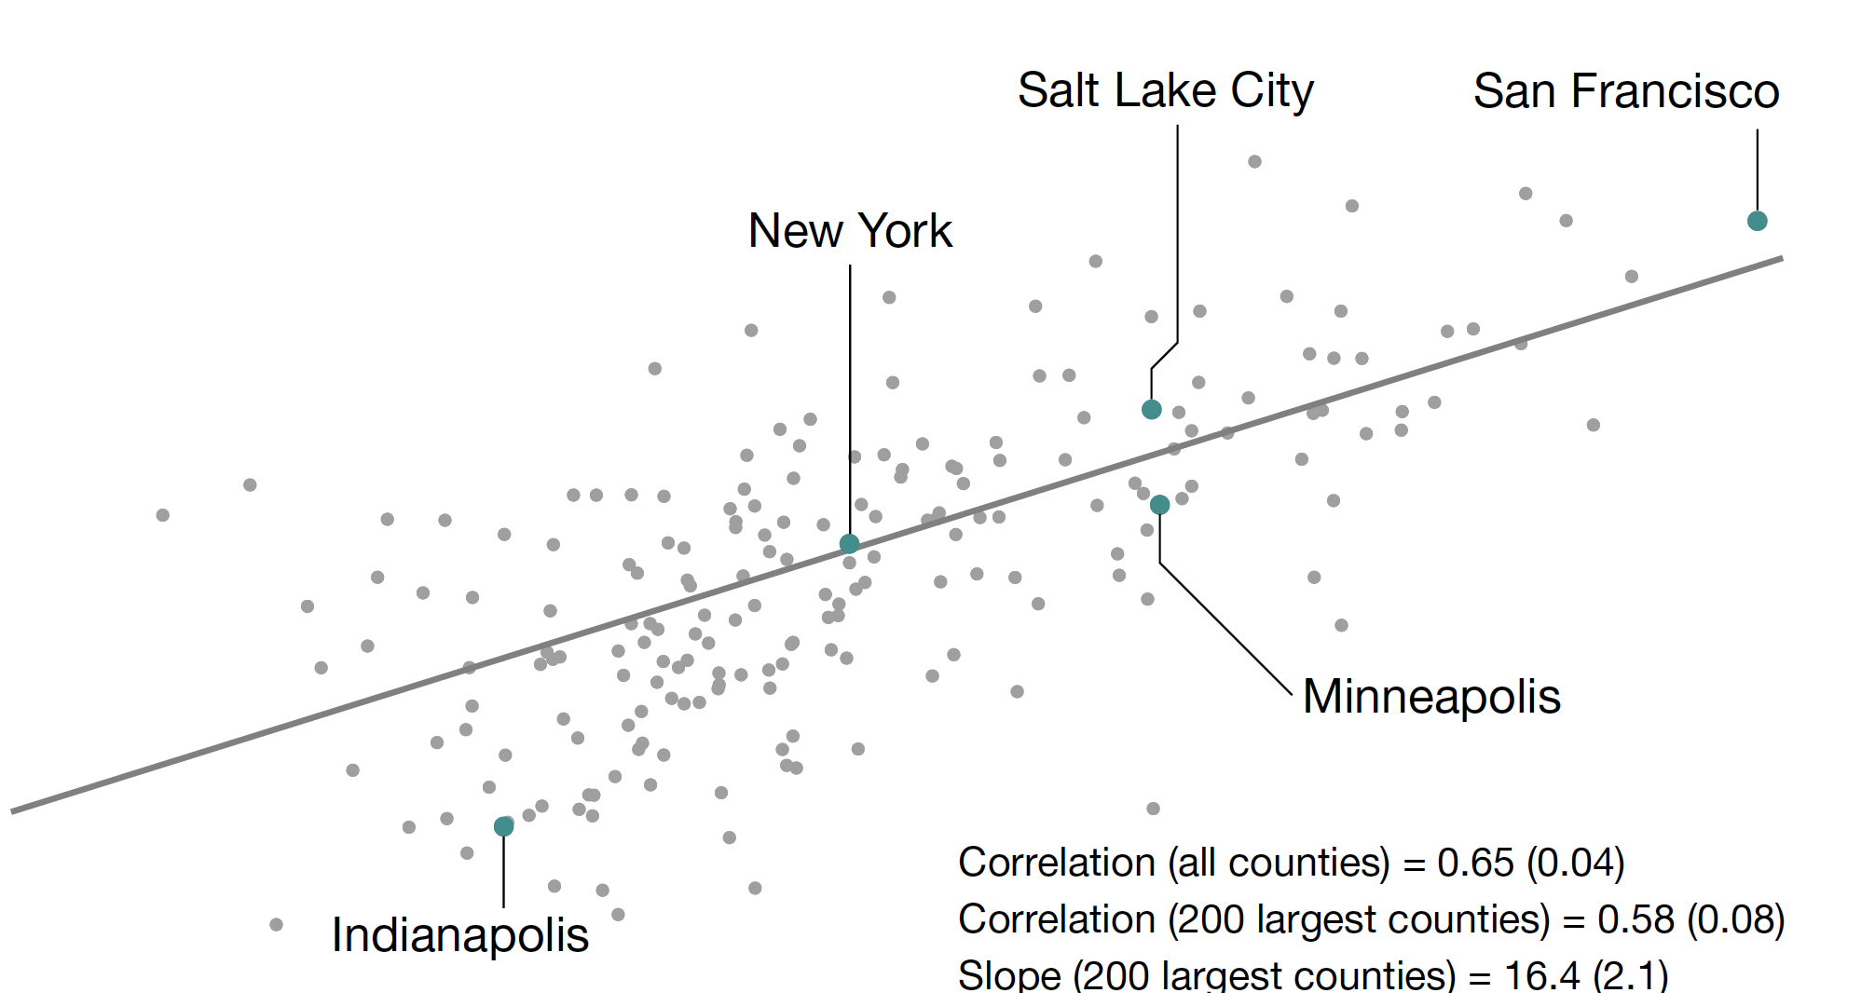
Upward Mobility vs. Economic Connectedness, by County
200 Largest Counties
55
Salt Lake City
San Francisco
50
New York
Upward Mobility Rate
45
Predicted Income Rank for Children with Parents at 25th percentile
40
Minneapolis
35
Correlation = 0.65
Indianapolis
30
20%
30%
40%
50%
60%
Share of Above-Median-SES Friends Among Below-Median-SES People
Source: Chetty, Friedman, Hendren, Jones, Porter (2018); Chetty, Jackson, Kuchler, Stroebel et al. (Nature 2022)

Slide 20
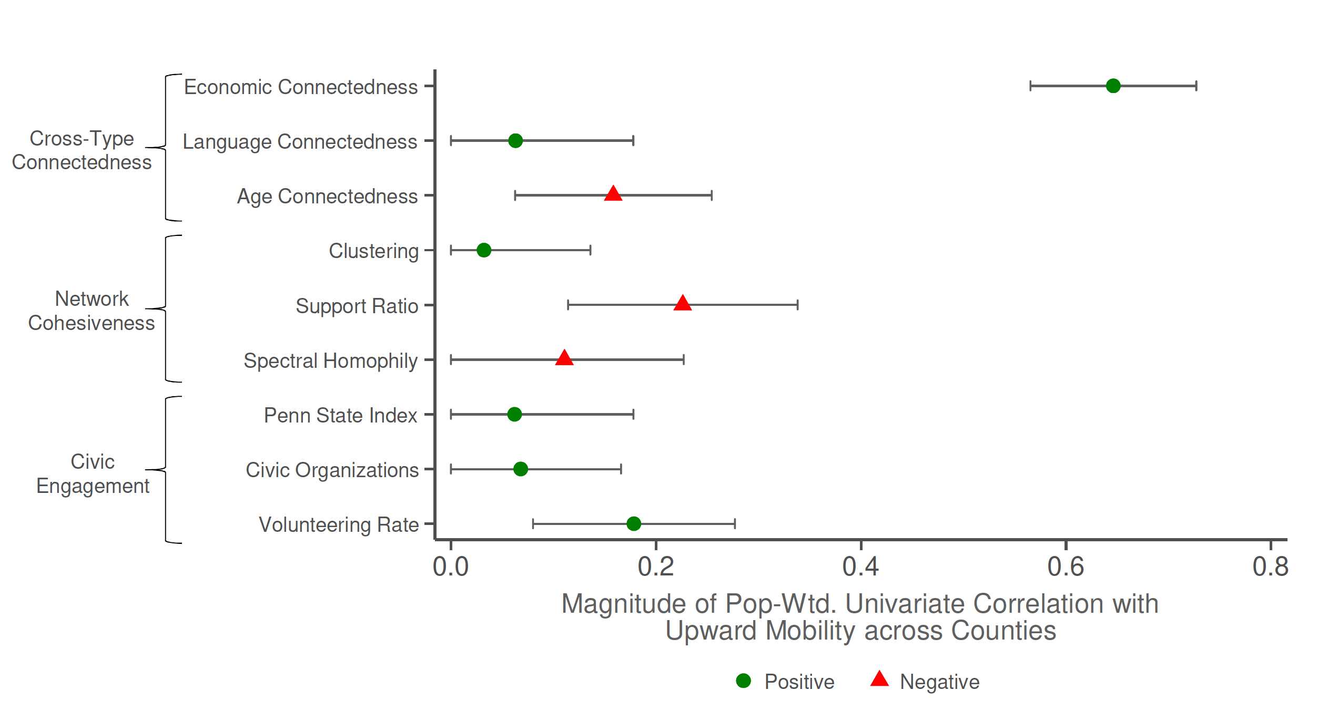
Correlations between Upward Mobility and Measures of Social Capital
County-level Univariate Correlations
Economic connectedness
Cross-Type Connectedness
Language connectedness
Age connectedness
Positive
Clustering
Negative
Network Cohesiveness
Support Ratio
Spectral homophily
Penn State Index
Civic Engagement
Civic Organizations
Volunteering Rate
0.0
0.2
0.4
0.6
0.8
Correlation between Population (weighted) and Upward Mobility across Counties
Source: Chetty, Friedman, Hendren, Jones, Porter (2018); Chetty, Jackson, Kuchler, Stroebel et al. (Nature 2022)
Notes:
1-3A

Slide 21



Ongoing Efforts to Increase Cross-Class Interaction
In Communities
In Recreational Groups
In Schools
The Richard King Mellon Foundation is issuing a Request for Proposals (RFP) that identify the factors that limit the formation of young people’s social connections across economic classes in Allegheny and Westmoreland counties and prototype interventions to increase these connections.
Where policy has failed, Innercity Weightlifting has succeeded in earning trust, creating hope, bridging social capital, and increasing opportunity for economic mobility.
Students are forming cross-class friendships. 85% connect
with their peer partner outside of class time.
Students who succeed are well positioned to attend four-year colleges.
Notes:
Representatives from these 3 examples will be in the audience
Richard King Mellon Foundation investments in social capital
- RFP to understand and develop an implementation toolkit for rural providers working on mobility in Allegheny and Westmoreland counties in Pennsylvania
Innercity Weightlifting
- gym/nonprofit in Boston that targets populations affected by mass incarceration and systemic racism by focusing on building relationships between students and staff of different socioeconomic backgrounds (through weightlifting/fitness classes)
AVID + AP Capstone Peer Mentorship program at Palo Alto High School, CA
Pilot program at CA high school that pairs low and high SES students who are rising into AP courses, pairs meet regularly and work towards structured learning targets
Stated goal of project is to reduce friending bias (directly citing OI)

Slide 22
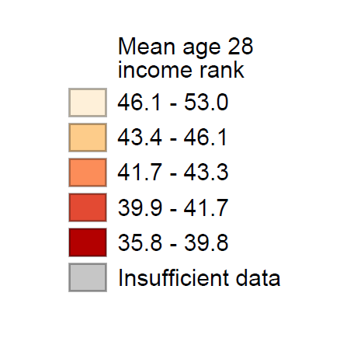
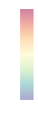
Economic Opportunity and Social Capital in the United Kingdom
Upward Mobility
Economic Connectedness Based on Facebook Data
40
46.1-53.0
50
41.7-43.3
60
35.8-39.8
70
Mean Income Rank at Age 28 for Men Born to Low-Income (Free School Lunch) Families
Average FB Friend SES Rank
Source: Carneiro, Cattan, Deardon, van der Erve, Krutikova, Macmillan (IFS Working Paper 2023); Rutter et al. (in progress)

Slide 23
Friending Bias: Cross-Class Friendships Formed Conditional on Exposure
Religious Groups
Recreational Groups
1.0
College
High School
Workplace
0.95
0.9
High-Income vs. Low-Income Friendships Formed Conditional On Exposure
0.85
Neighborhood
0.8
0.75
Source: Chetty, Jackson, Kuchler, Stroebel et al. (Nature 2022a,b)

Slide 24
Friending Bias vs. Exposure to High-SES Students, By High School
-10
Less friending bias
0
Friending Bias among
Low-Parental-SES Students (%)
10
20
20
40
60
80
Share of High-Parental-SES Students (%)
More exposure
Source: Chetty, Jackson, Kuchler, Stroebel et al. (Nature 2022b)

Slide 25
Friending Bias Among Low-SES People, By Setting
20%
Neighborhood
College
More Friending Bias
10%
High School
Workplace
Recreational Groups
Religious Groups
0%
Source: Chetty, Jackson, Kuchler, Stroebel et al. (Nature 2022a,b)

Slide 26
Friending Bias: Cross-Class Friendships Formed Conditional on Exposure
Religious Groups
Recreational Groups
1.0
College
High School
Workplace
0.95
0.9
High-Income vs. Low-Income Friendships Formed Conditional On Exposure
0.85
Neighborhood
0.8
0.75
Source: Chetty, Jackson, Kuchler, Stroebel et al. (Nature 2022a,b)
Notes:
Another version of the previous slide

